Slide 1
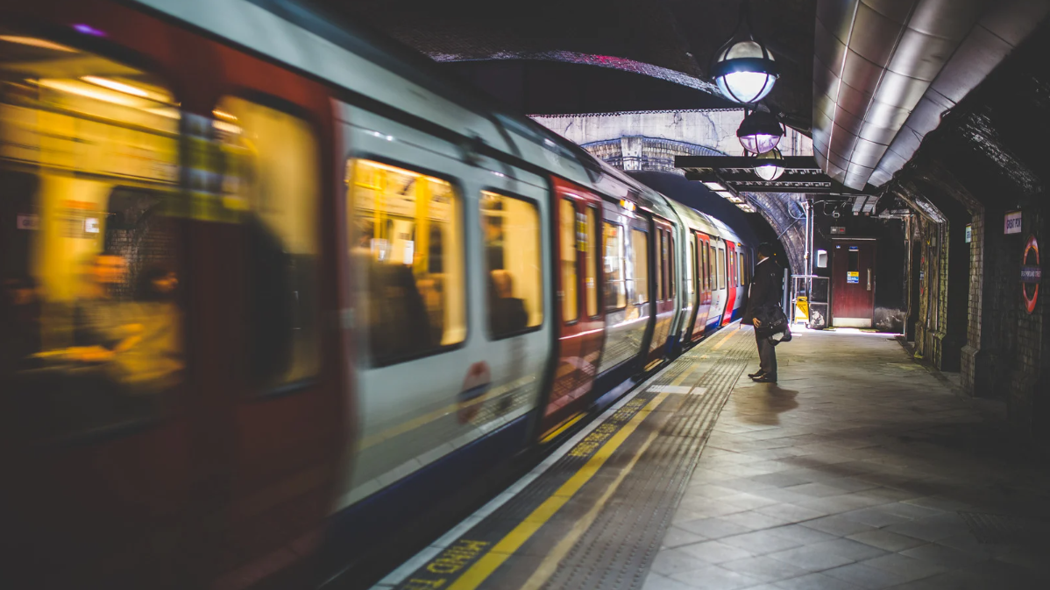
MTA Turnstile Data Analysis
Exploring Subway Traffic
for Street Engagement of
WTWY Associaton
Team Members
Bahar TURGUT İNAN
Murat TOPÇUOĞLU
Elif ERDAL
Berk EYÜBOĞLU
Selçuk TÜRK

Slide 2

Goal
Choosing the optimum placement of street teams at the subway entrances to maximize the participation and donation rate to the gala.

Slide 3





Methodology
Data
MTA Turnstile Data
MTA_Subway_Hourly_Ridership (March’23 – May’23)
Click here for data dictionary
Tools
Jupyter Notebook
Pandas
Numpy
Mathplotlib
Seaborn

Slide 4





What’ s Wrong with the Data?
The gala will be held on summer, so we can use the data between March and May.
New York is such a beautiful city that the subway could be very attractive for tourists at weekends. So we focused on only weekdays.
No null values
No duplicated values
The ridership column is not cumulative, so we can use sum() function.
We created columns for date, time, time grouping and name of day.
Here is the final data…

Slide 5
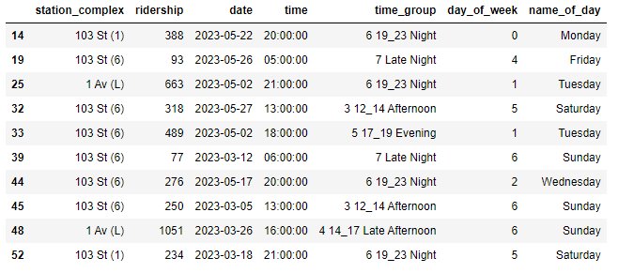
Final Data

Slide 6
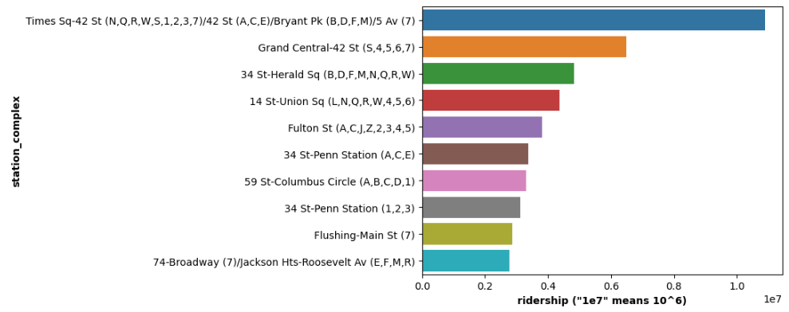
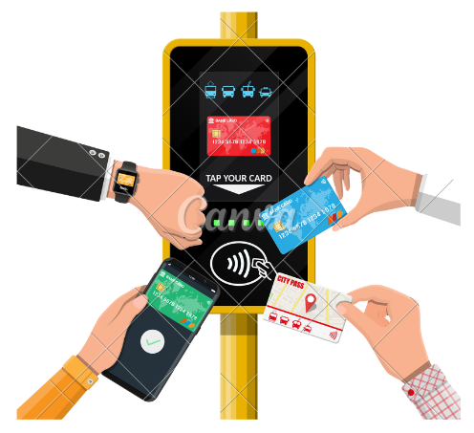
Graphs & Analytics
The Busiest Top Three Stations
Times Sq-42 St
Grand Central-42 St
34 St- Herald Sq

Slide 7
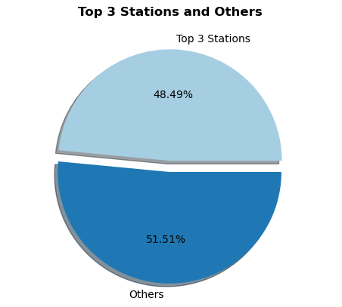
Graphs & Analytics
Half of our all passengers are at our three busiest statitions.

Slide 8
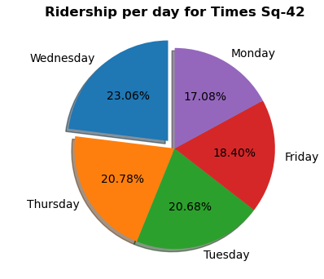
Graphs & Analytics
The Busiest Day for Times Sq-42 St
Wednesday is the busiest day for Times Sq-42 St

Slide 9
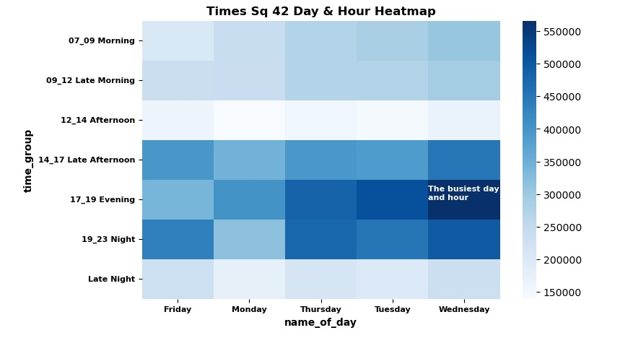
Graphs & Analytics
The Busiest Hour for Times Sq-42 St
« 17:00 - 19:00 Evening » is the most busiest time for all days except Friday and Thursday.

Slide 10
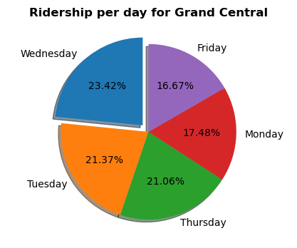
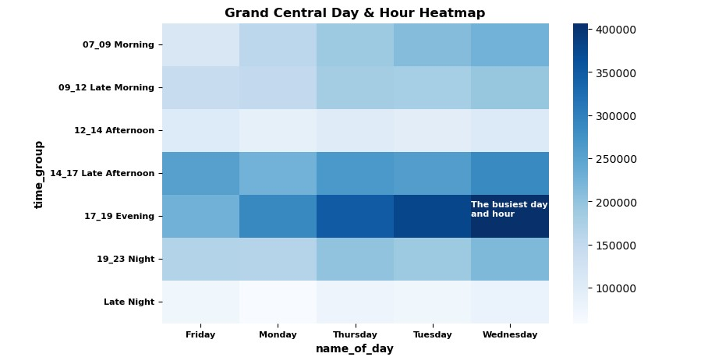
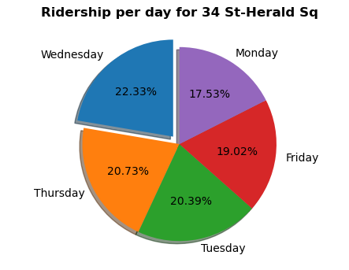
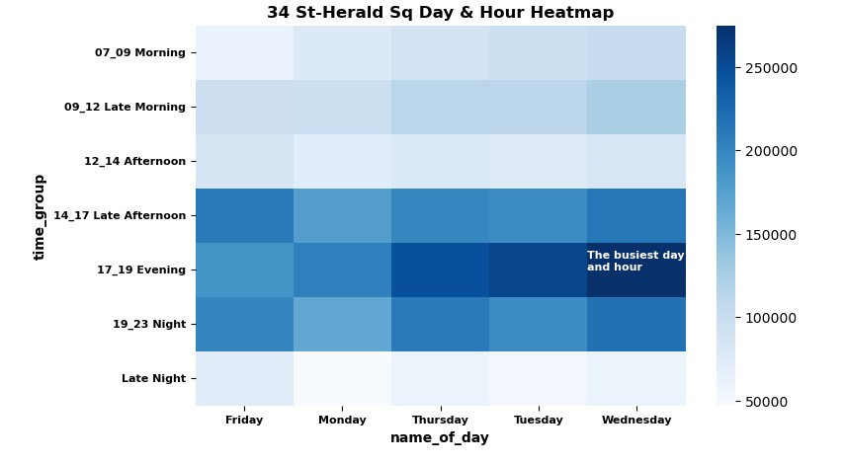
Graphs & Analytics
The other two stations also have the same results as Times Sq-42 St.
Wednesday
17:00 - 19:00

Slide 11
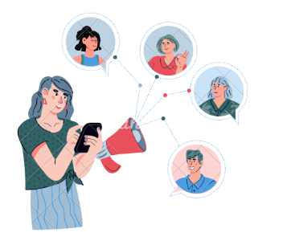
Conclusions & Recommendations
The busiest three stations (Times Sq-42 St, Grand Central-42 St,34 St- Herald Sq) have the most ridership on Wednesdays between 17:00 and 19:00. So the street teams should be located around those stations at that day and time.
In addition Friday and Thursday have a significant number of ridership between 19:00 and 23:00. If the association has more street teams, they can be located around the stations on those times.

Slide 12


What’s Next?
Exploring the areas where the population of women working in tech are high.
For increasing the amount of donation we can use additional data to target individuals who has high income.

Slide 13


